Slide 1


Machine
Learning
Demystifying the World of Artificial Intelligence and Exploring Its Potential

Slide 2
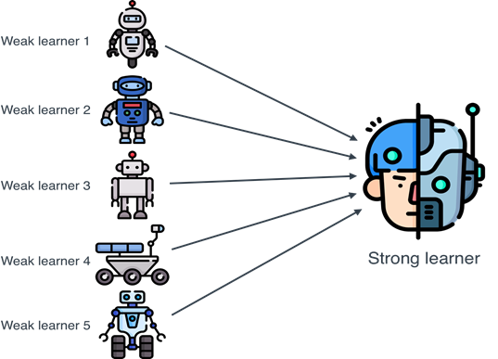
Ensemble Learning
a machine learning technique that aggregates two or more learners in order to produce better predictions.
Machine Learning

Slide 3

What Is Ensemble Learning?
Imagine you need to choose people to take their votes to help you to answer questions.
You have two options:
Machine Learning

Slide 4

What Is Ensemble Learning?
Imagine you need to choose people to take their votes to help you to answer questions.
You have two options:
Choosing some of your friends randomly
Machine Learning

Slide 5

What Is Ensemble Learning?
Imagine you need to choose people to take their votes to help you to answer questions.
You have two options:
Choosing some of your friends randomly
Choosing experts in different fields to complete each other
Machine Learning

Slide 6
What Is Ensemble Learning?
Imagine you need to choose people to take their votes to help you to answer questions.
You have two options:
Choosing some of your friends randomly
Choosing experts in different fields to complete each other
}
Bagging
Machine Learning

Slide 7
What Is Ensemble Learning?
Imagine you need to choose people to take their votes to help you to answer questions.
You have two options:
Choosing some of your friends randomly
Choosing experts in different fields to complete each other
}
}
Bagging
Boosting
Machine Learning

Slide 8
What Is Ensemble Learning?
Imagine you need to choose people to take their votes to help you to answer questions.
You have two options:
Choosing some of your friends randomly
Choosing experts in different fields to complete each other
}
}
Bagging
Boosting
Ensemble Learning
Machine Learning

Slide 9
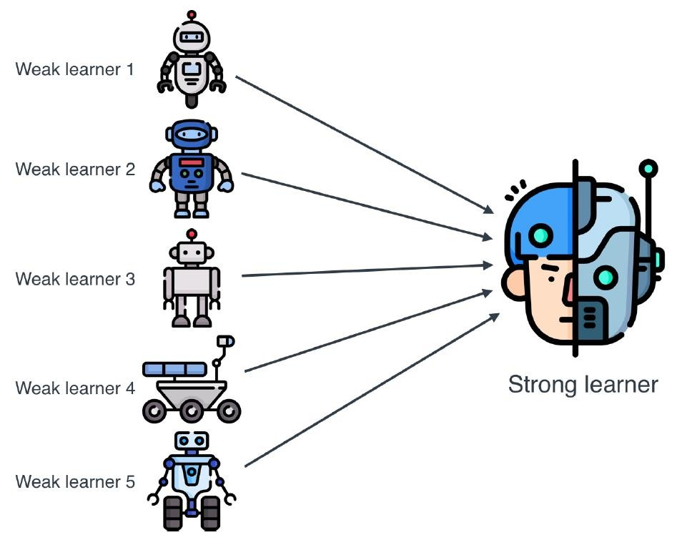
What Is Ensemble Learning?
Ensemble Learning:
Combine weak learners to form a strong one.
Learners could be any type of machine learning model.
Ensemble Learning types:
Bagging
Boosting

Slide 10
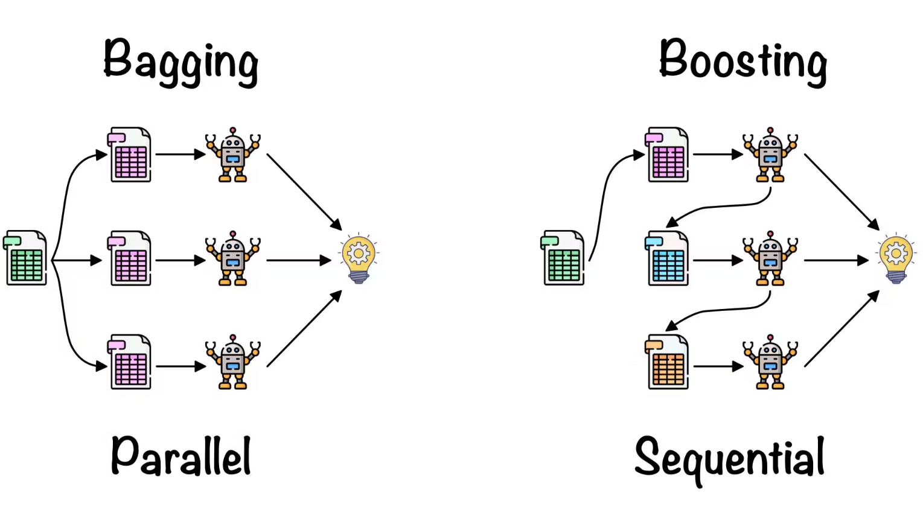
Bagging
an ensemble method that involves training multiple models independently on random subsets of the data and aggregating their predictions through voting or averaging.
Machine Learning

Slide 11
Bagging
A technique in which we build a strong learner based on a set of weak learners trained on data splitted randomly and making predictions by voting.
If these learners are decision trees, then our model is called Random Forest.
Random Forest Steps:
Split data randomly into sets.
Train each decision tree at one of these sets.
Take decision based on vote between these models.
Machine Learning

Slide 12
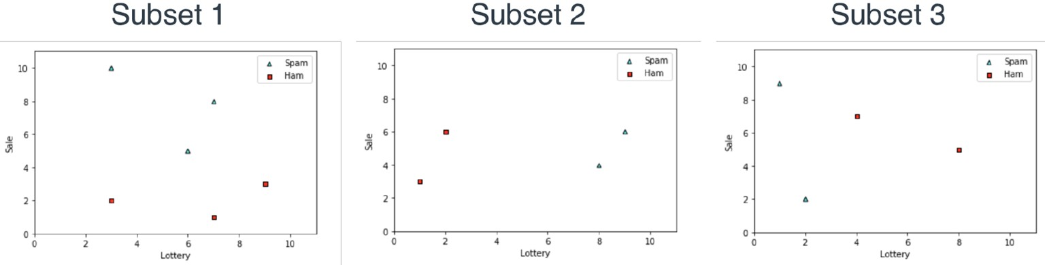
Bagging
A technique in which we build a strong learner based on a set of weak learners trained on data splitted randomly and making predictions by voting.
If these learners are decision trees, then our model is called Random Forest.
Random Forest Steps:
Split data randomly into sets.
Train each decision tree at one of these sets.
Take decision based on vote between these models.
Machine Learning

Slide 13
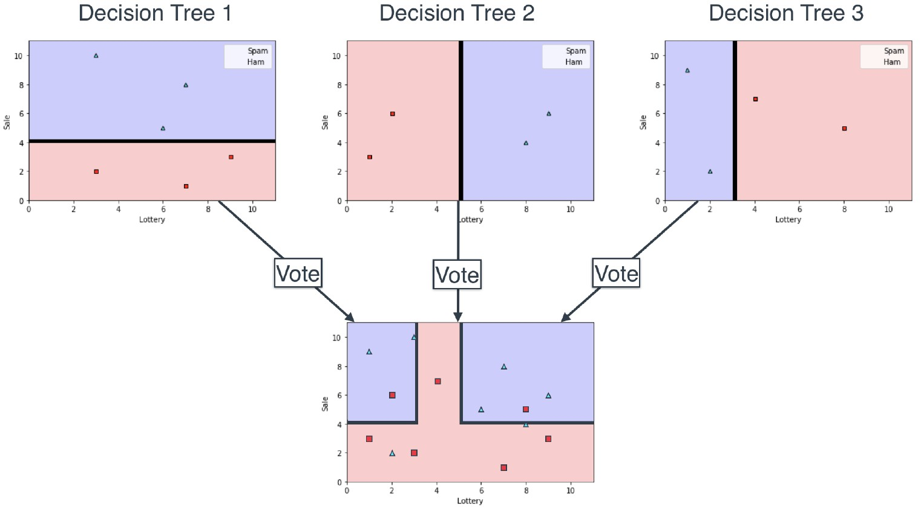
Bagging
A technique in which we build a strong learner based on a set of weak learners trained on data splitted randomly and making predictions by voting.
If these learners are decision trees, then our model is called Random Forest.
Random Forest Steps:
Split data randomly into sets.
Train each decision tree at one of these sets.
Take decision based on vote between these models.
Machine Learning

Slide 14
Boosting
to increase or improve something: The company is looking for ways to boost sales in Asia, its biggest market.
Machine Learning

Slide 15
Boosting
A technique in which we build a strong learner based on a set of weak learners not randomly selected but trained in a smarter way and making predictions by voting. Ex: AdaBoost, XGBoost
Each model trained to cover the weakness of the previous ones.
Machine Learning

Slide 16
Boosting
A technique in which we build a strong learner based on a set of weak learners not randomly selected but trained in a smarter way and making predictions by voting. Ex: AdaBoost, XGBoost
Each model trained to cover the weakness of the previous ones.
Machine Learning

Slide 17
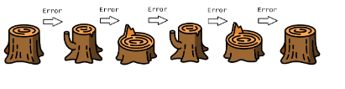
AdaBoost
a statistical classification meta-algorithm formulated by Yoav Freund and Robert Schapire in 1995
Machine Learning

Slide 18
AdaBoost (Adaptive Boosting)
Using very simple learners (1-depth decision tree) to build a strong learner
Steps:
Train the first learner
Increase the weight of the data samples that learner predicts incorrectly
Decrease the weight of the data samples that learner predicts correctly
Train another learner using the modified dataset
Repeat steps 2,3,4 for all other learners
Make the prediction using the weighted voting based on the performance of each learner
AdaBoost could be used for classification or regression.
Our example is a classification problem.
Machine Learning

Slide 19
AdaBoost [Big Picture]
Building the learners
Our learners are very simple.
Ex: 1-Depth Decision Tree
Machine Learning

Slide 20
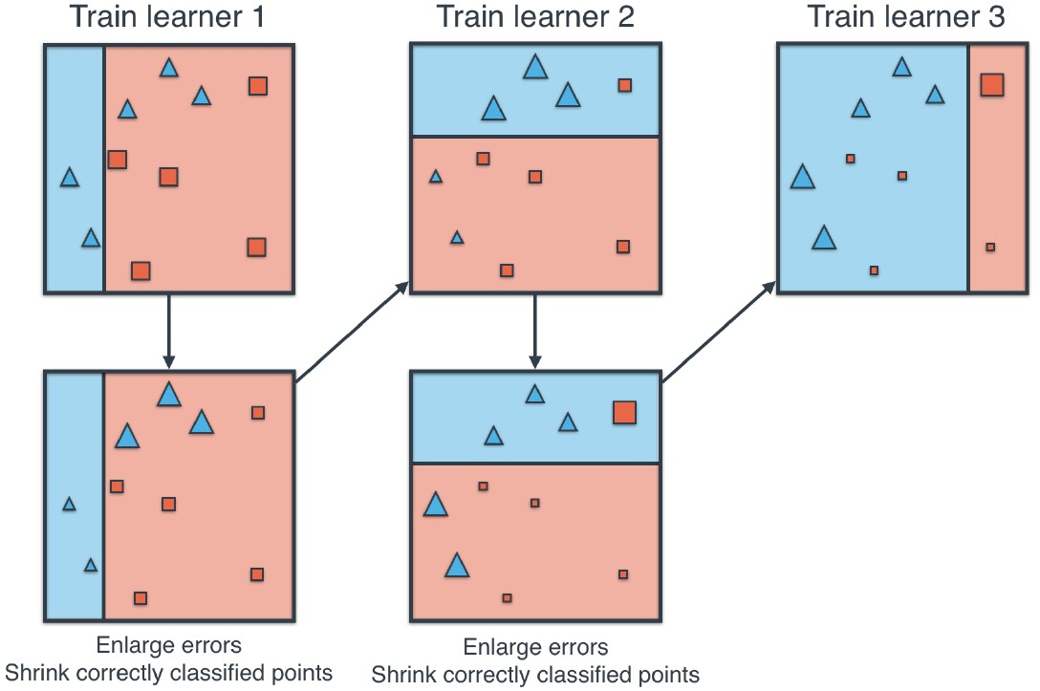
AdaBoost [Big Picture]
Building the learners
Our learners are very simple.
Ex: 1-Depth Decision Tree
Machine Learning

Slide 21
AdaBoost [Big Picture]
Building the learners
Our learners are very simple.
Ex: 1-Depth Decision Tree
Machine Learning

Slide 22
AdaBoost [Big Picture]
Building the learners
Our learners are very simple.
Ex: 1-Depth Decision Tree
Machine Learning

Slide 23
AdaBoost [Big Picture]
Building the learners
Our learners are very simple.
Ex: 1-Depth Decision Tree
Machine Learning

Slide 24
AdaBoost [Big Picture]
Building the learners
Our learners are very simple.
Ex: 1-Depth Decision Tree
Machine Learning

Slide 25
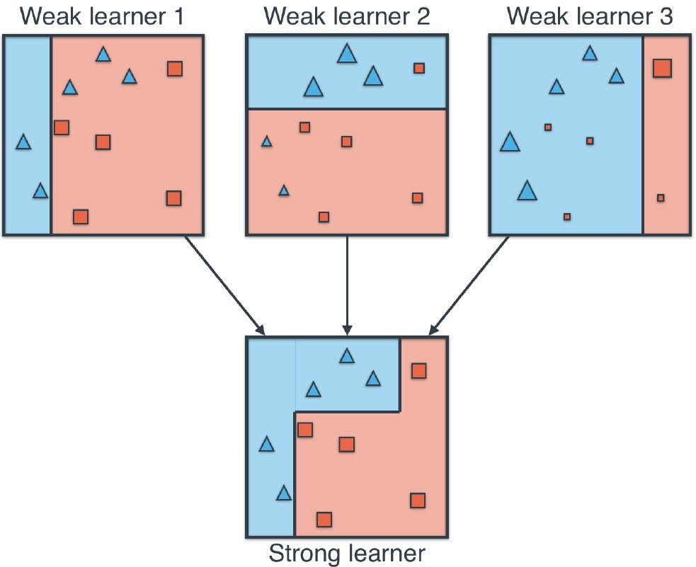
AdaBoost [Big Picture]
Prediction
Machine Learning

Slide 26
AdaBoost [Big Picture]
Prediction
Machine Learning

Slide 27
AdaBoost [Big Picture]
Prediction
Need to answer two questions:
How to change the points weights?
How to choose the weight of each learner while prediction?
Machine Learning

Slide 28
AdaBoost [In Details]
How to update the weights?
Let’s introduce the Odd Ratio
Number of correctly classified points
Odd Ratio
=
_____________________________________________
Number of incorrectly classified points
Machine Learning

Slide 29
AdaBoost [In Details]
How to update the weights?
Let’s introduce the Odd Ratio
Number of correctly classified points
=
Rescaling Factor
Odd Ratio
=
_____________________________________________
Number of incorrectly classified points
Machine Learning

Slide 30
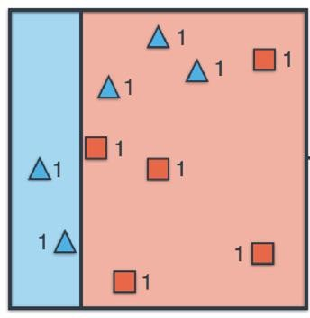
AdaBoost [In Details]
How to update the weights?
Let’s introduce the Odd Ratio
Rescaling Factor
=
Number of correctly classified points
=
_____________________________________________
Odd Ratio
Number of incorrectly classified points
ex: 1st learner
Machine Learning

Slide 31
AdaBoost [In Details]
How to update the weights?
Let’s introduce the Odd Ratio
Rescaling Factor
=
Number of correctly classified points
=
_____________________________________________
Odd Ratio
Number of incorrectly classified points
Rescaling Factor = 7/3 = 2.33
ex: 1st learner
Machine Learning

Slide 32
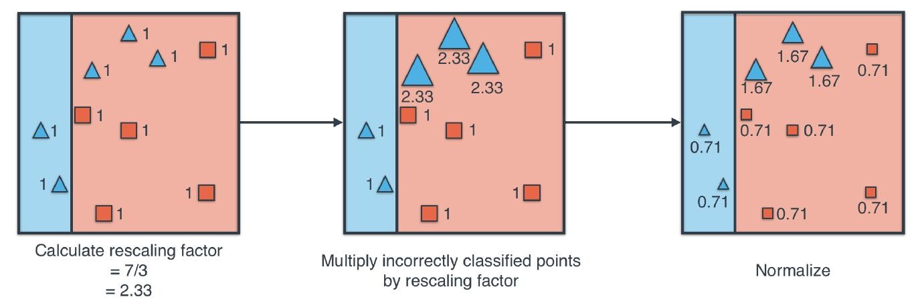
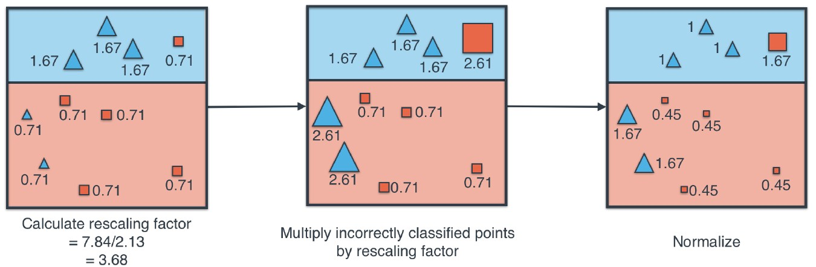
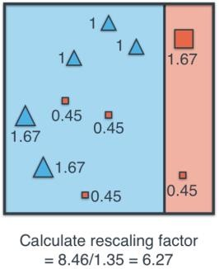
AdaBoost [In Details]
How to update the weights? [Steps]
Train the learner
Calculate the rescaling factor
Multiply incorrected classified
Points by the rescaling factor
Normalize the weights
1st learner
2nd
learner
3rd learner
Machine Learning

Slide 33
AdaBoost [In Details]
How to update the weights? [Steps]
Train the learner
Calculate the rescaling factor
Multiply incorrected classified Points by the rescaling factor
Normalize the weights
1st learner
2nd
learner
3rd learner
Machine Learning

Slide 34
AdaBoost [In Details]
How to update the weights? [Steps]
Train the learner
Calculate the rescaling factor
Multiply incorrected classified Points by the rescaling factor
Normalize the weights
1st learner
2nd
learner
3rd learner
Machine Learning

Slide 35
AdaBoost [In Details]
How to update the weights? [Steps]
Train the learner
Calculate the rescaling factor
Multiply incorrected classified Points by the rescaling factor
Normalize the weights
1st learner
2nd
learner
3rd learner
Machine Learning

Slide 36
AdaBoost [In Details]
How to update the weights? [Steps]
Train the learner
Calculate the rescaling factor
Multiply incorrected classified Points by the rescaling factor
Normalize the weights
1st learner
3rd learner
2nd
learner
Machine Learning

Slide 37
AdaBoost [In Details]
How to update the weights? [Steps]
Train the learner
Calculate the rescaling factor
Multiply incorrected classified Points by the rescaling factor
Normalize the weights
1st learner
3rd learner
2nd
learner
Machine Learning

Slide 38
AdaBoost [In Details]
How to update the weights? [Steps]
Train the learner
Calculate the rescaling factor
Multiply incorrected classified Points by the rescaling factor
Normalize the weights
1st learner
3rd learner
2nd
learner
Machine Learning

Slide 39
AdaBoost [In Details]
How to update the weights? [Steps]
Train the learner
Calculate the rescaling factor
Multiply incorrected classified Points by the rescaling factor
Normalize the weights
1st learner
3rd learner
2nd
learner
Machine Learning

Slide 40
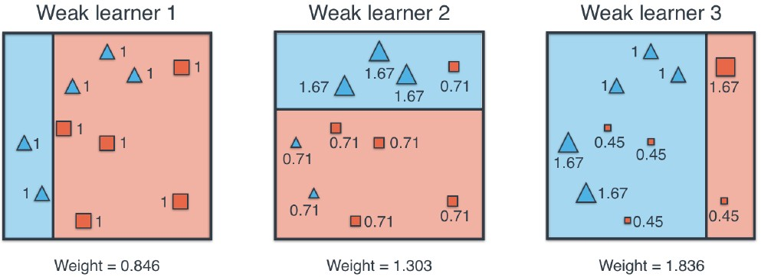
AdaBoost [In Details]
Weight of each learner while prediction?
Machine Learning

Slide 41
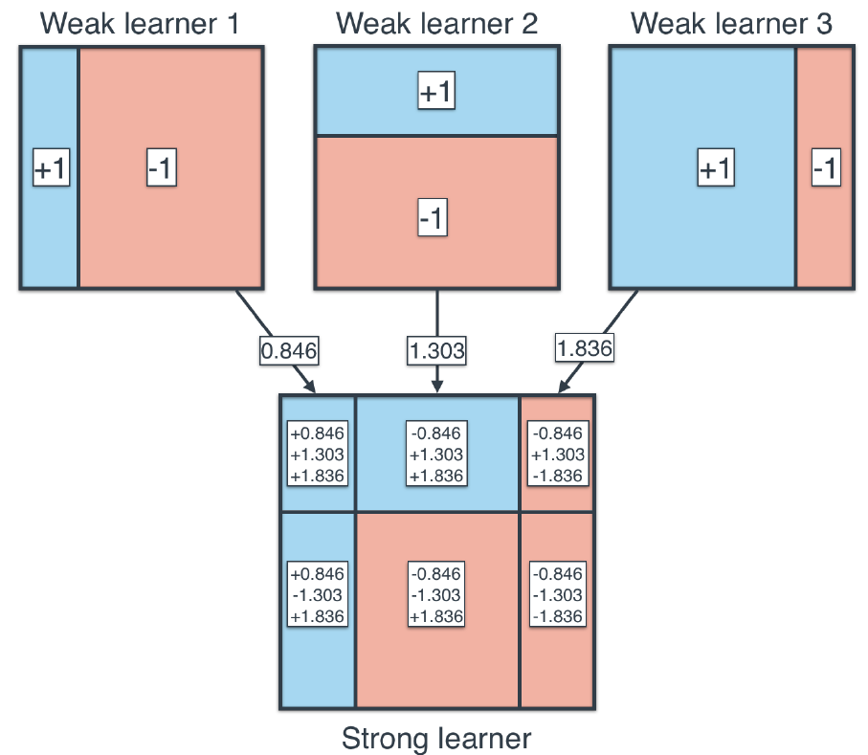
AdaBoost [In Details]
Weight of each learner while prediction?
Machine Learning

Slide 42
AdaBoost [In Details]
Weight of each learner while prediction?
Machine Learning

Slide 43
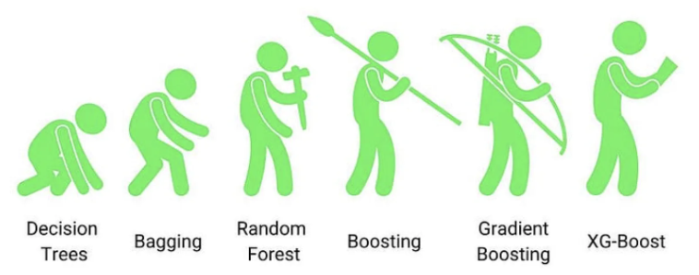
XGBoost
a classification algorithm. It's designed for problems where you have a bunch of training data that can be used to create a classifier, and then you have new data that you want to classify.
Machine Learning

Slide 44
XGBoost
AdaBoost consists of 1-depth weak learners. What if we build a similar algorithm with deeper trees?
XGBoost could be used for classification or regression.
Our example is a regression problem.
Steps:
Start with a naive learner that predicts 0.5 in all cases
Calculate residual between predicted and label
Build a new learner to predict the residual
Repeat step 2,3 for other learners
Combine all learners to get the prediction
Machine Learning

Slide 45
XGBoost
AdaBoost consists of 1-depth weak learners. What if we build a similar algorithm with deeper trees?
XGBoost could be used for classification or regression.
Our example is a regression problem.
Steps:
Start with a naive learner that predicts 0.5 in all cases
Calculate residual between predicted and label
Build a new learner to predict the residual
Repeat step 2,3 for other learners
Combine all learners to get the prediction
Need to answer two questions:
How to build the learner?
How to combine the learners to make the prediction?
Machine Learning

Slide 46
XGBoost
How to build the learner?
In XGBoost we use a similarity instead of Gini and Entropy
Square of sum of labels of the set
Similarity
=
_____________________________________________
Number of points of the set + λ
Machine Learning

Slide 47
XGBoost
How to build the learner?
In XGBoost we use a similarity instead of Gini and Entropy
Square of sum of labels of the set
Similarity
=
_____________________________________________
Number of points of the set + λ
let λ = 0
Machine Learning

Slide 48
XGBoost
How to build the learner?
In XGBoost we use a similarity instead of Gini and Entropy
Square of sum of labels of the set
Similarity
=
_____________________________________________
Number of points of the set + λ
let λ = 0
Example: If we have three sets with these labels {10, -10, 4}, {7, 7, 7}, {7}
Machine Learning

Slide 49

XGBoost
How to build the learner?
In XGBoost we use a similarity instead of Gini and Entropy
Square of sum of labels of the set
Similarity
=
_____________________________________________
Number of points of the set + λ
let λ = 0
Example: If we have three sets with these labels {10, -10, 4}, {7, 7, 7}, {7}
Machine Learning

Slide 50

XGBoost
How to build the learner?
In XGBoost we use a similarity instead of Gini and Entropy
Square of sum of labels of the set
Similarity
=
_____________________________________________
Number of points of the set + λ
let λ = 0
Example: If we have three sets with these labels {10, -10, 4}, {7, 7, 7}, {7}
Machine Learning

Slide 51

XGBoost
How to build the learner?
In XGBoost we use a similarity instead of Gini and Entropy
Square of sum of labels of the set
Similarity
=
_____________________________________________
Number of points of the set + λ
let λ = 0
Example: If we have three sets with these labels {10, -10, 4}, {7, 7, 7}, {7}
Machine Learning

Slide 52
XGBoost
How to build the learner?
In XGBoost we use a similarity instead of Gini and Entropy
Square of sum of labels of the set
Similarity
=
_____________________________________________
Number of points of the set + λ
let λ = 0
Example: If we have three sets with these labels {10, -10, 4}, {7, 7, 7}, {7}
This is not a perfect similarity metric as it gives high priority for high values, but this is good for our purpose as we will see.
Machine Learning

Slide 53
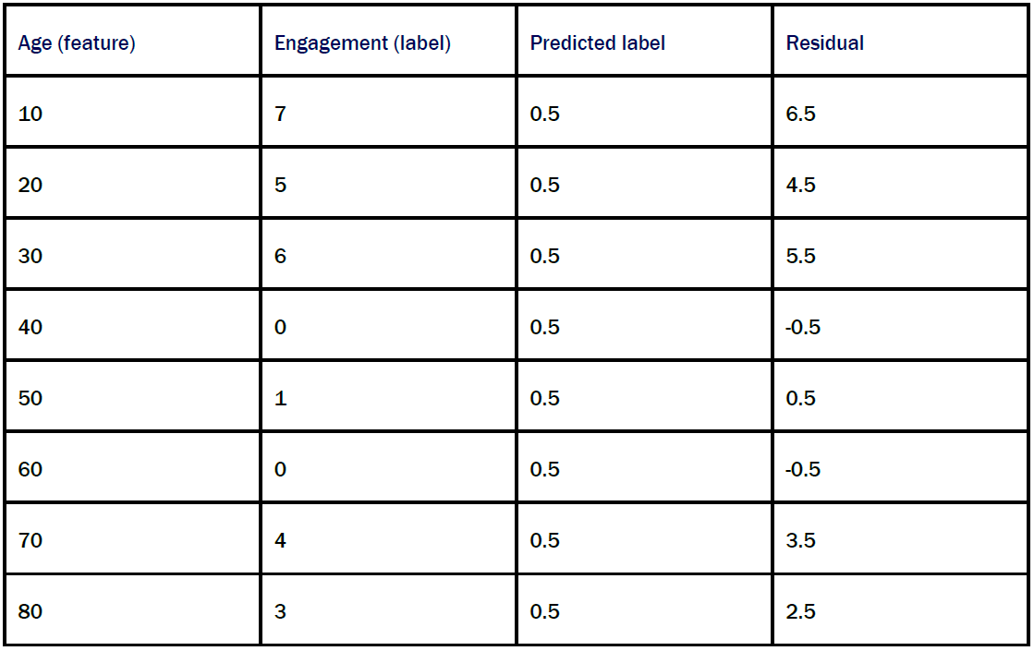
XGBoost
Building the learners
Step1:
Start with a naive learner that predicts 0.5 in all cases
Machine Learning

Slide 54
XGBoost
Building the learners
Step1:
Start with a naive learner that predicts 0.5 in all cases
Machine Learning

Slide 55
XGBoost
Building the learners
Step1:
Start with a naive learner that predicts 0.5 in all cases
Step2:
Calculate residual between predicted and label
Machine Learning

Slide 56
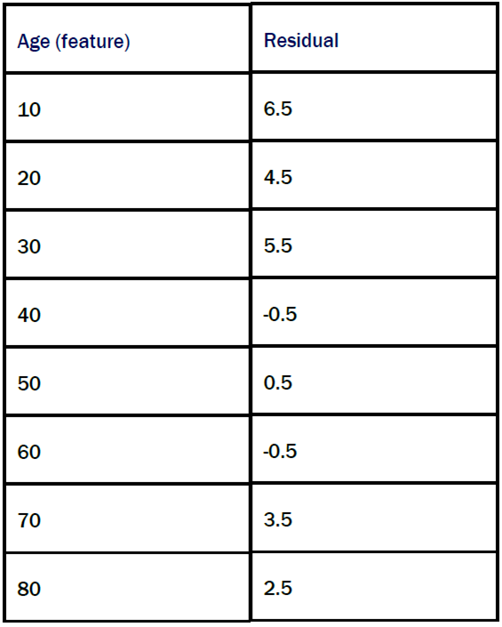
XGBoost
Building the learners
Step3:
Build a decision tree to predict the residual based on similarity gain
Base similarity:
Machine Learning

Slide 57


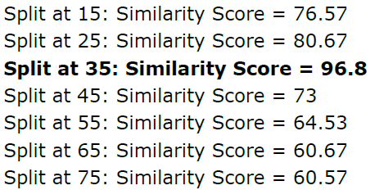
XGBoost
Building the learners
Step3:
Build a decision tree to predict the residual based on similarity gain
Base similarity:
Machine Learning

Slide 58
XGBoost
Building the learners
Step3:
Build a decision tree to predict the residual based on similarity gain
Base similarity:
- Base similarity
Machine Learning

Slide 59
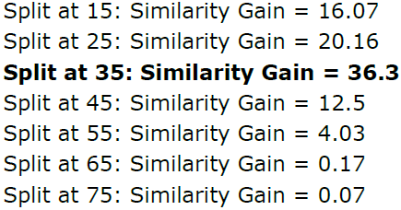
XGBoost
Building the learners
Step3:
Build a decision tree to predict the residual based on similarity gain
Base similarity:
- Base similarity
Machine Learning

Slide 60
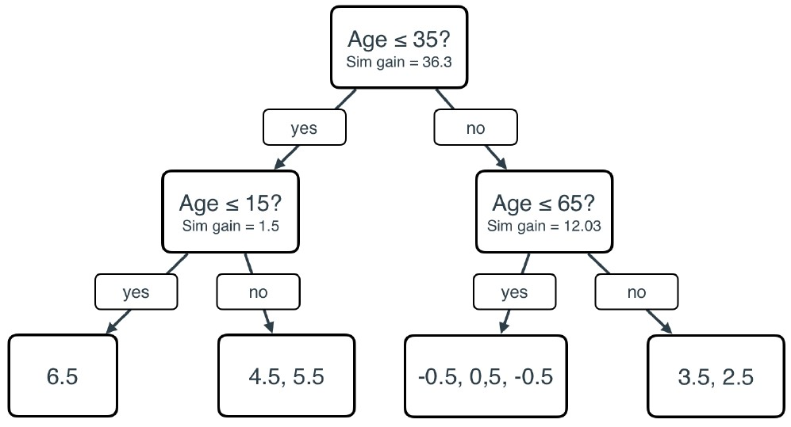
XGBoost
Building the learners
Step3:
Build a decision tree to predict the residual based on similarity gain
Machine Learning

Slide 61
XGBoost
Hyperparameters:
Maximum Tree Depth: If increased, Overfitting increased.
Number Of Trees: Number of learners (estimators)
Minimum Number Of Elements Per Leaf: If increased, Overfitting decreased.
Minimum Similarity Gain (gamma γ): Minimum gain to split. If increased, Overfitting decreased.
Lambda λ: If increased, similarity gain decrease, Overfitting decreased.
Learning Rate (eta η): The percentage of prediction that we take to not take the full step of decreasing.
Machine Learning

Slide 62
XGBoost
Machine Learning

Slide 63
XGBoost
Tree Pruning:
Stop splitting or remove leaves based on the above hyperparameters.
For example, we set “Minimum Similarity
Gain (gamma γ)” to 5
Machine Learning

Slide 64
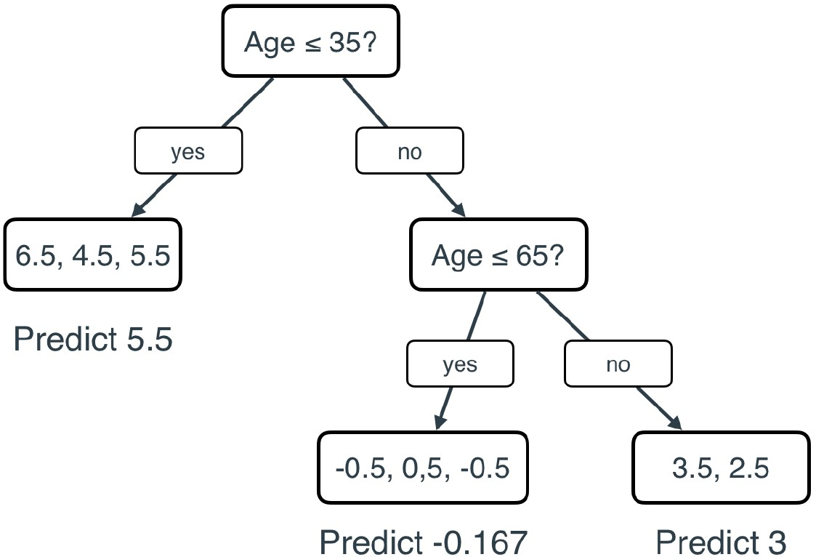
XGBoost
Tree Pruning:
Stop splitting or remove leaves based on the above hyperparameters.
For example, we set “Minimum Similarity
Gain (gamma γ)” to 5
Machine Learning

Slide 65
XGBoost
Steps till now:
Start with a naive learner that predicts 0.5 in all cases
Calculate residual of learner 1
Build learner 2 to fit the residual
Multiply the predictions of learner 2 by learning rate (η), say 0.7
Calculate the new predictions (learner 1 preds + learner 2 preds )
Why?
Calculate the new resuals
Machine Learning

Slide 66
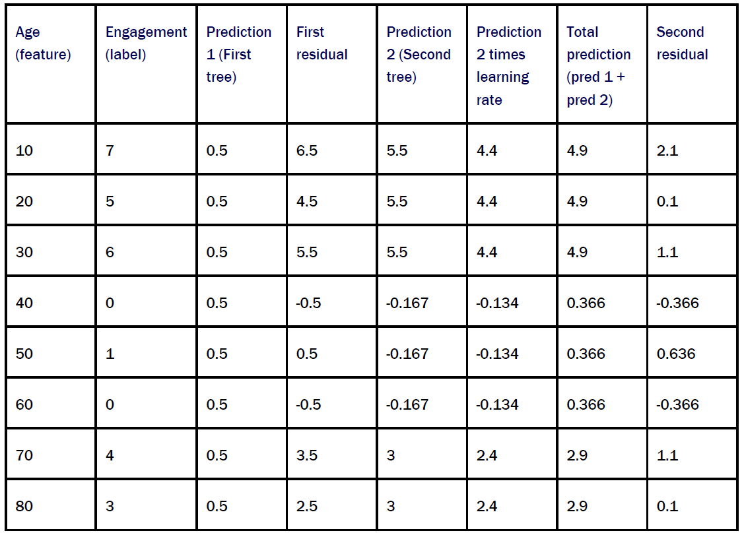
XGBoost
Steps till now:
Start with a naive learner that predicts 0.5 in all cases
Calculate residual of learner 1
Build learner 2 to fit the residual
Multiply the predictions of learner 2 by learning rate (η), say 0.7
Calculate the new predictions (learner 1 preds + learner 2 preds )
Why?
Calculate the new resuals
Machine Learning

Slide 67
XGBoost
Steps till now:
Start with a naive learner that predicts 0.5 in all cases
Calculate residual of learner 1
Build learner 2 to fit the residual
Multiply the predictions of learner 2 by learning rate (η), say 0.7
Calculate the new predictions (learner 1 preds + learner 2 preds )
Why?
Calculate the new resuals
Machine Learning

Slide 68
XGBoost
Steps till now:
Start with a naive learner that predicts 0.5 in all cases
Calculate residual of learner 1
Build learner 2 to fit the residual
Multiply the predictions of learner 2 by learning rate (η), say 0.7
Calculate the new predictions (learner 1 preds + learner 2 preds )
Why?
Calculate the new resuals
Machine Learning

Slide 69
XGBoost
Steps till now:
Start with a naive learner that predicts 0.5 in all cases
Calculate residual of learner 1
Build learner 2 to fit the residual
Multiply the predictions of learner 2 by learning rate (η), say 0.7
Calculate the new predictions (learner 1 preds + learner 2 preds )
Why?
Calculate the new resuals
Machine Learning

Slide 70
XGBoost
Steps till now:
Start with a naive learner that predicts 0.5 in all cases
Calculate residual of learner 1
Build learner 2 to fit the residual
Multiply the predictions of learner 2 by learning rate (η), say 0.7
Calculate the new predictions (learner 1 preds + learner 2 preds )
Why?
Calculate the new resuals
Machine Learning

Slide 71
XGBoost
Steps till now:
Start with a naive learner that predicts 0.5 in all cases
Calculate residual of learner 1
Build learner 2 to fit the residual
Multiply the predictions of learner 2 by learning rate (η), say 0.7
Calculate the new predictions (learner 1 preds + learner 2 preds )
Why?
Calculate the new resuals
Machine Learning

Slide 72
XGBoost
Steps till now:
Start with a naive learner that predicts 0.5 in all cases
Calculate residual of learner 1
Build learner 2 to fit the residual
Multiply the predictions of learner 2 by learning rate (η), say 0.7
Calculate the new predictions (learner 1 preds + learner 2 preds )
Why?
Calculate the new resuals
Machine Learning

Slide 73
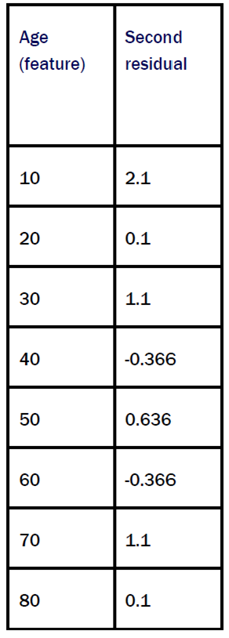
XGBoost
Time to build learner 3 with the same way
Machine Learning

Slide 74
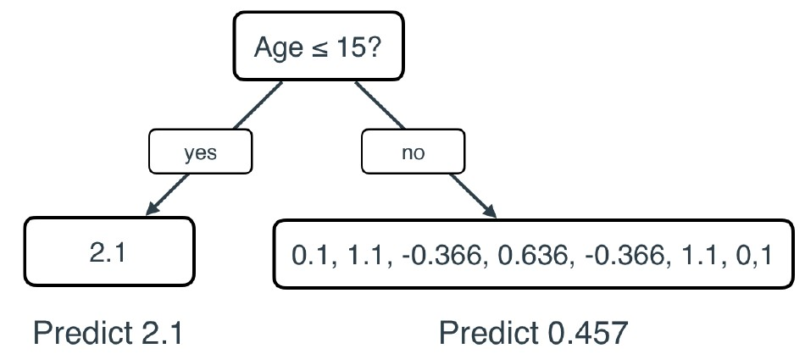
XGBoost
Time to build learner 3 with the same way
Machine Learning

Slide 75
XGBoost
Time to build learner 3 with the same way
To get the predictions from learner 3, we multiply the output by the learning rate (0.7)
Machine Learning

Slide 76
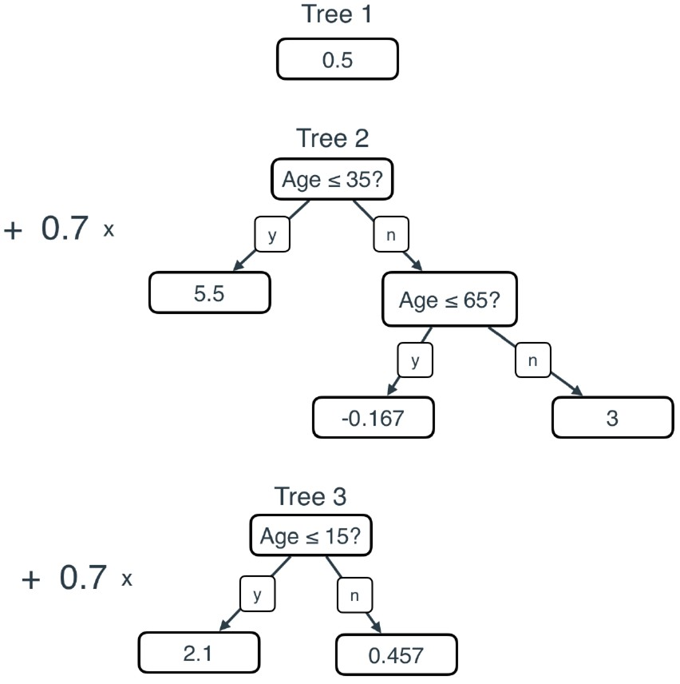
XGBoost
The full model:
Machine Learning

Slide 77
XGBoost
The full model:
Final prediction = Prediction 1 + 0.7 * Prediction 2 + 0.7 * Prediction 3
Machine Learning

Slide 78
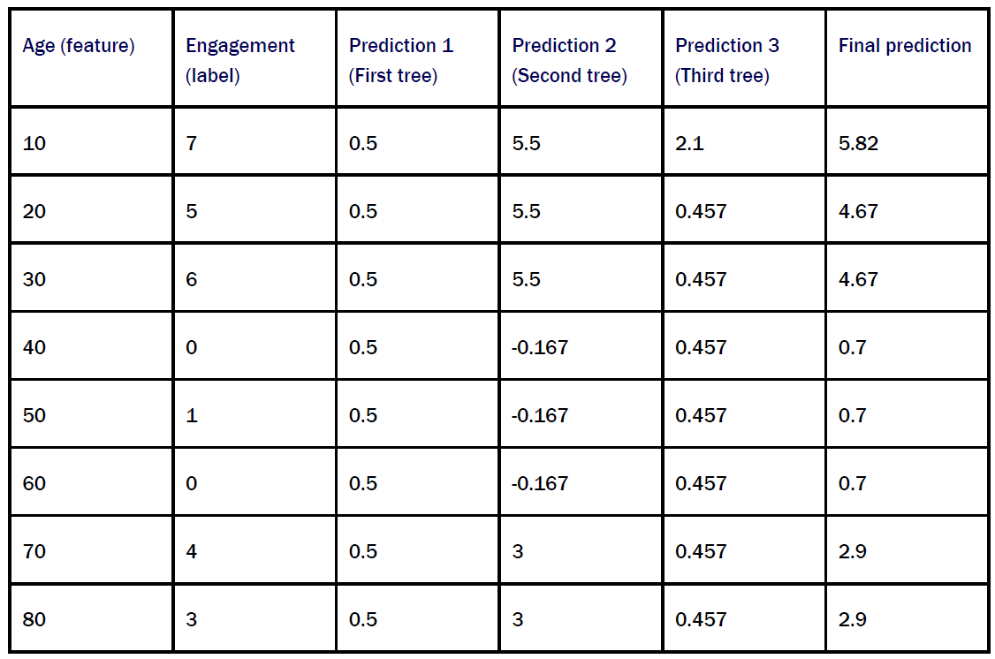
XGBoost
The full model:
Final prediction = Prediction 1 + 0.7 * Prediction 2 + 0.7 * Prediction 3
Machine Learning

Slide 79
THANK YOU!
Any Question!

